Slide 1
Multiple Source Optimal Power Flow
Aryan Ritwajeet Jha
Pursuing PhD ECE (Power Systems)
Washington State University
Notes:
Remember to hit the reset button to make sure all the page elements react properly.
There are 20 different layouts that you can choose from.

Slide 2
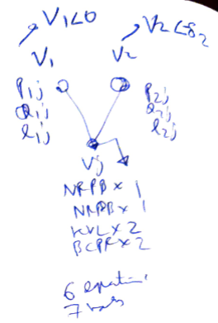
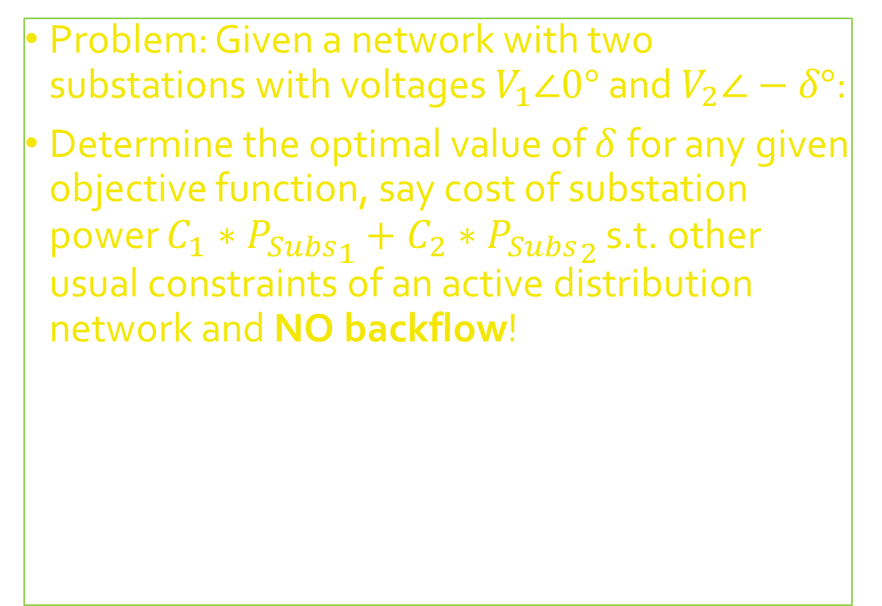

Multiple Sources = $2$ Substations* Network = $2$ Substations + $2$ Branches + $1$ Load* (*for now..)
Problem: Given a network with two substations with voltages $V_{1}∠0°$ and $V_{2}∠−δ°$:
Determine the optimal value of $δ$ for any given objective function, say cost of substation power $C_{1}∗{P_{Subs}}_{1}+C_{2}∗{P_{Subs}}_{2}$ s.t. other usual constraints of an active distribution network and NO backflow!

Slide 3
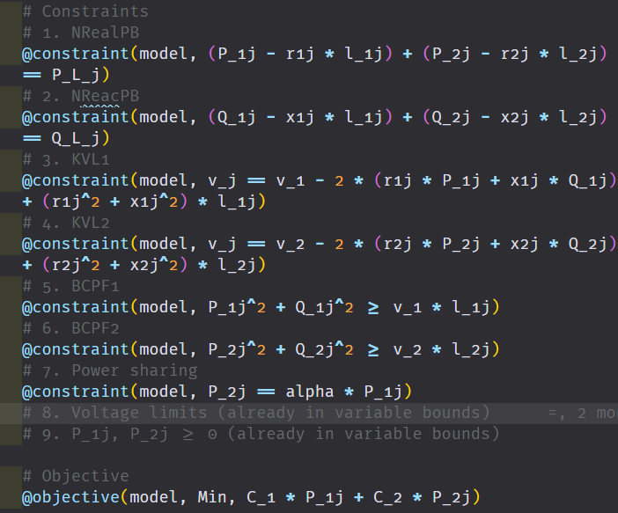
Optimization using BFM-NL
Using Branch Flow Model (Nonlinear) I can optimize for the optimal power flow of the network – note that BFM does not take into consideration (relative) voltage angles of the substations.
Is the modelling (and thus the solution) even correct?

Slide 4
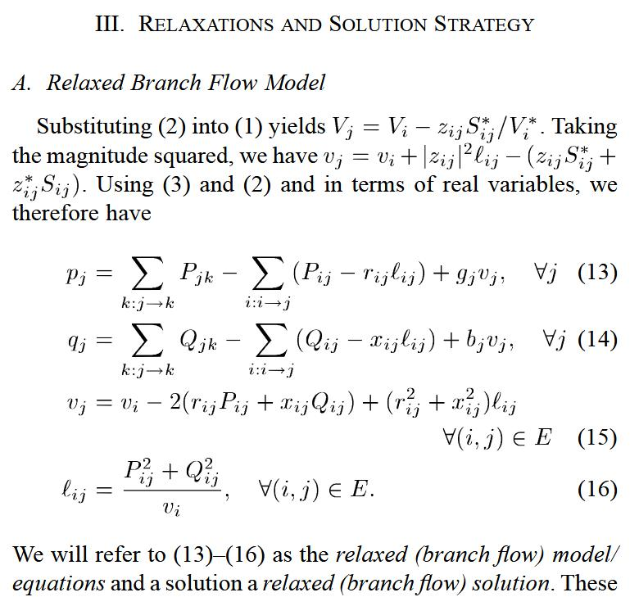
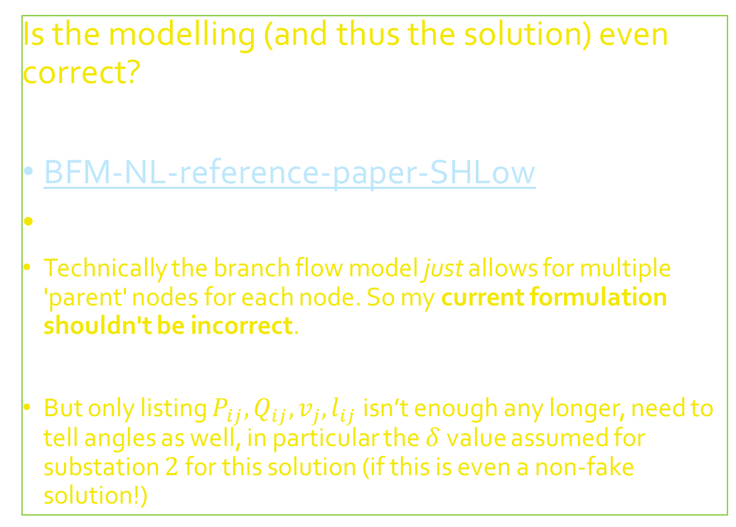
Optimization using BFM-NL
Is the modelling (and thus the solution) even correct?
BFM-NL-reference-paper-SHLow
Technically the branch flow model just allows for multiple 'parent' nodes for each node. So my current formulation shouldn't be incorrect.
But only listing $P_{ij}, Q_{ij}, v_{j}, l_{ij}$ isn’t enough any longer, need to tell angles as well, in particular the $δ$ value assumed for substation $2$ for this solution (if this is even a non-fake solution!)

Slide 5
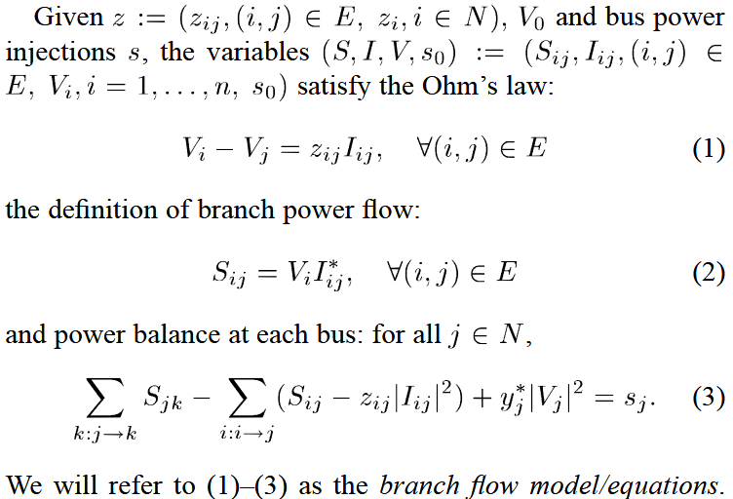
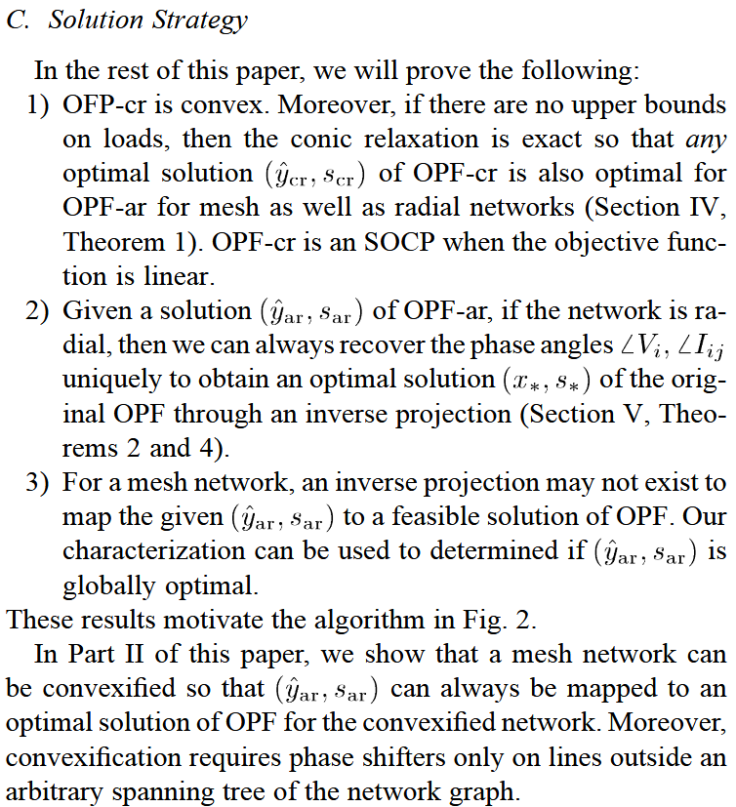
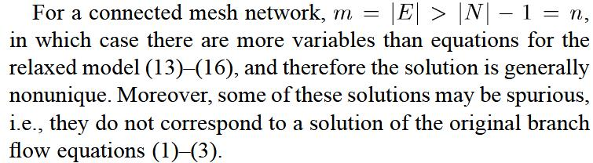
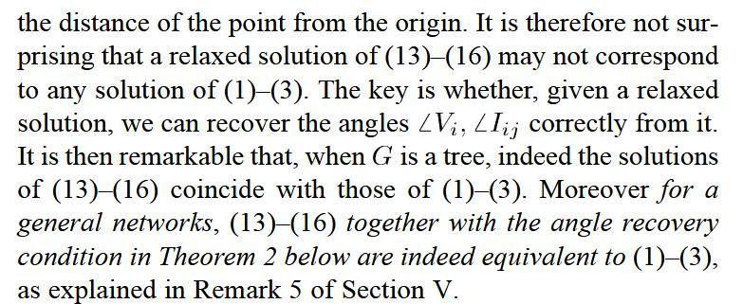
Optimization using BFM-NL
It looks like I need to study part II of the paper to understand the angle recovery process – nonunique and nontrivial for ‘meshed’ systems

Slide 6
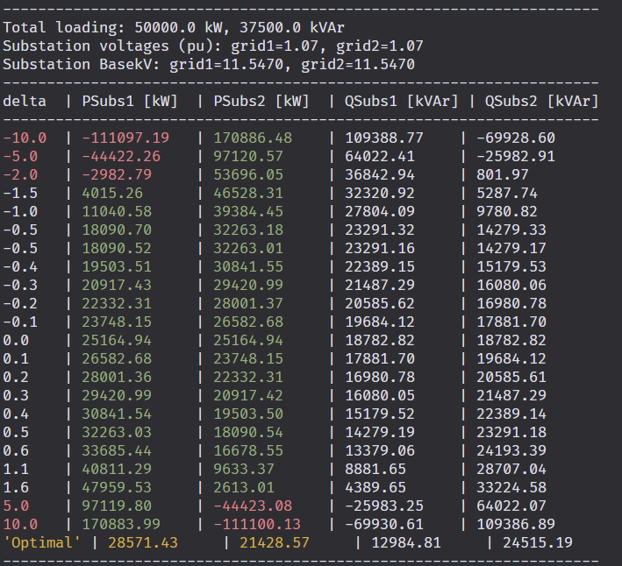

Meanwhile I’ve created the same system in OpenDSS where I am running powerflows for different values for $δ$ – it does look like our solution should have a feasible value associated with it.

Slide 7


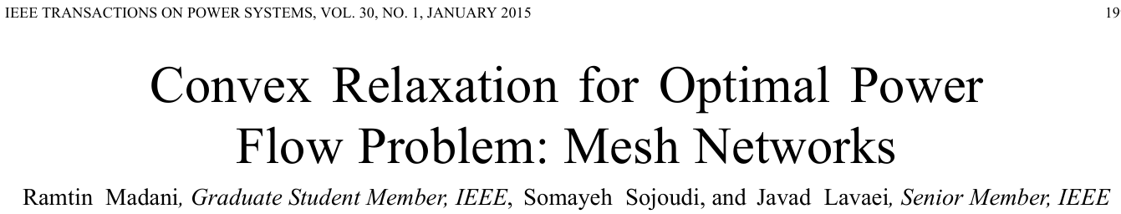
Given some papers by Subho to read

